Slide 1
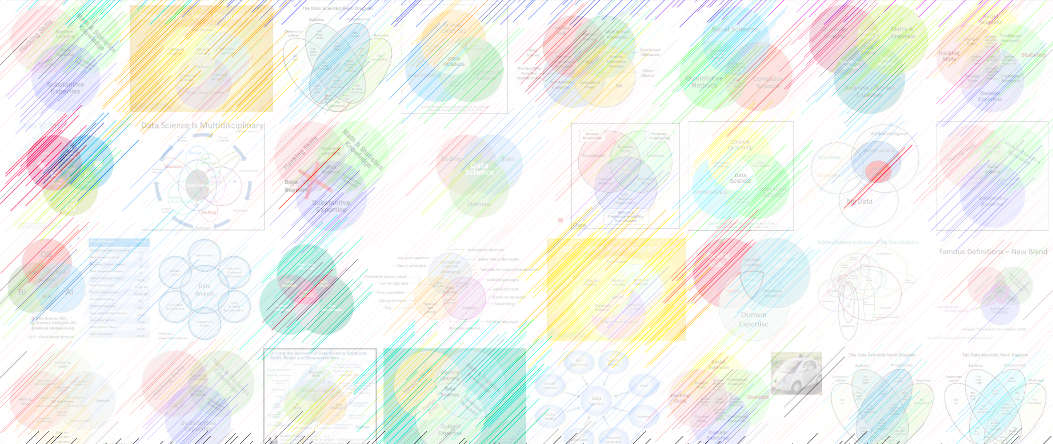

DATA221 Intro Machine Learning 06 misc fitting issues
William Trimble
Spring 2023

Slide 2
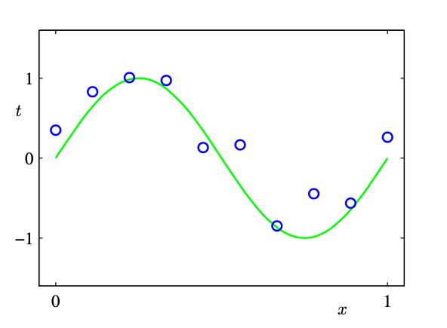
Linear (polynomial coefficient) regression example
Artificial “training” dataset :
y = sin(2 𝜋 x) + 0.1 * N (mean=0, std=1)
Example from Bishop, Pattern Recognition and Machine Learning (2006)

Slide 3
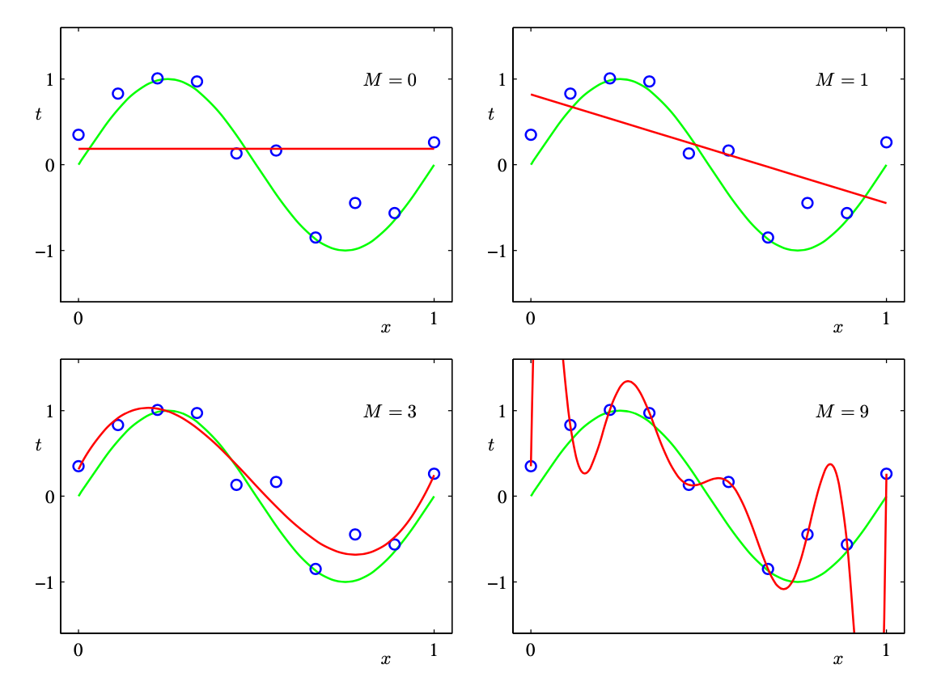
OLS fits to polynomial coefficients minimizing mean squared error.
constant,
linear,
cubic and
x⁹ - polynomials

Slide 4
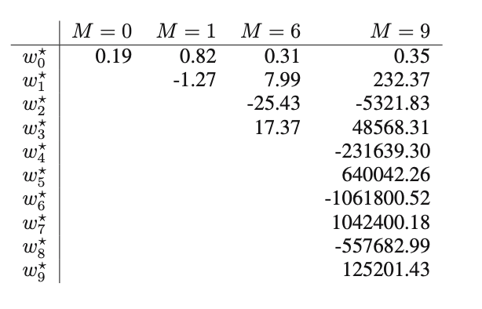
If you look at the coefficients, they don’t inspire confidence:
More complex models have fit coefficients that start to look ugly:

Slide 5
Why does it do this?
A = Sum_{i} e_{i}^{T} λ_{i} e_{i}
n
A
e₁^{T}
Q⁻¹
Σ
Q
λ₁
e₂
e₃
e₄
=
e₂^{T}
λ₂
n
det A = Π λ_{i}
e₃^{T}
λ₃
e₄^{T}
λ₄
n
A⁻¹
e₁^{T}
Q⁻¹
Σ
Q
λ₁⁻¹
e₂
e₃
e₄
=
e₂^{T}
λ₂⁻¹
n
e₃^{T}
λ₃¹⁻
det A⁻¹ = Π λ_{i}⁻¹
e₄^{T}
λ₄⁻¹

Slide 6
Why does it do this?
A = Sum_{i} e_{i}^{T} λ_{i} e_{i}
n
A
e₁^{T}
Q⁻¹
Σ
Q
λ₁
e₂
e₃
e₄
When pairs of rows/ columns in A are close but not the same,
eigenvalues of A get small. Jargon: “Ill-conditioned design matrix”
Small eigenvaules… operator attenuates some directions…
inverse has LARGE values… tend to amplify noise.
=
e₂^{T}
λ₂
n
det A = Π λ_{i}
e₃^{T}
λ₃
e₄^{T}
λ₄
n
A⁻¹
e₁^{T}
Q⁻¹
Σ
Q
λ₁⁻¹
e₂
e₃
e₄
=
e₂^{T}
λ₂⁻¹
n
e₃^{T}
λ₃¹⁻
det A⁻¹ = Π λ_{i}⁻¹
e₄^{T}
λ₄⁻¹

Slide 7
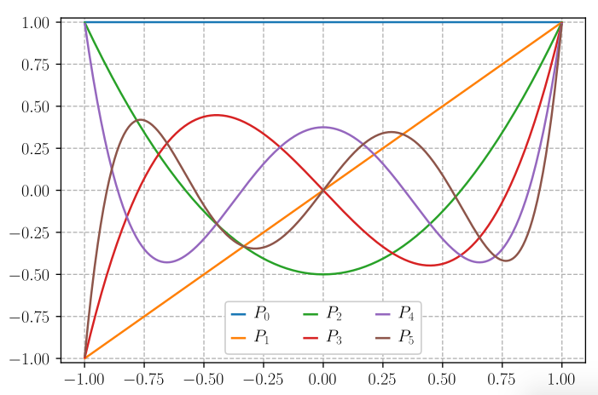
One approach is
choosing basis
vectors that are
orthogonal:
”in different directions”
won’t interfere with
each other.
These are polynomials constructed to have 0 inner product when integrated from -1 to 1.

Slide 8
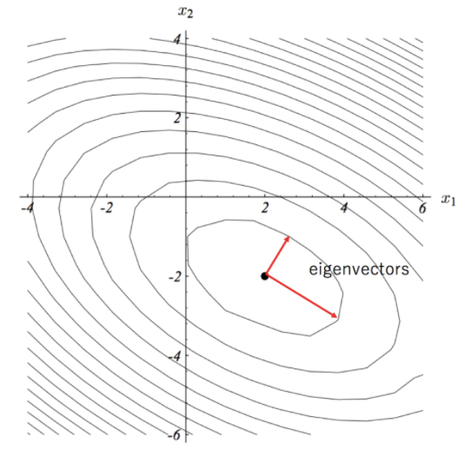
So what? some eigenvalues are small.
This doesn’t do anything bad, does it?
b = (X^{T} X)⁻¹X^{T} Y
The inverse of X^{T} X has eigenvalues that
are the inverses of the eigenvalues in X^{T} X.
So small eigenvalues in X^{T} X mean large
eigenvalues (and large volume transformations)
in (X^{T} X)⁻¹
But.. I’m applying (X^{T} X)⁻¹ to something
proportional to Y, which has ”noise” on it.

Slide 9
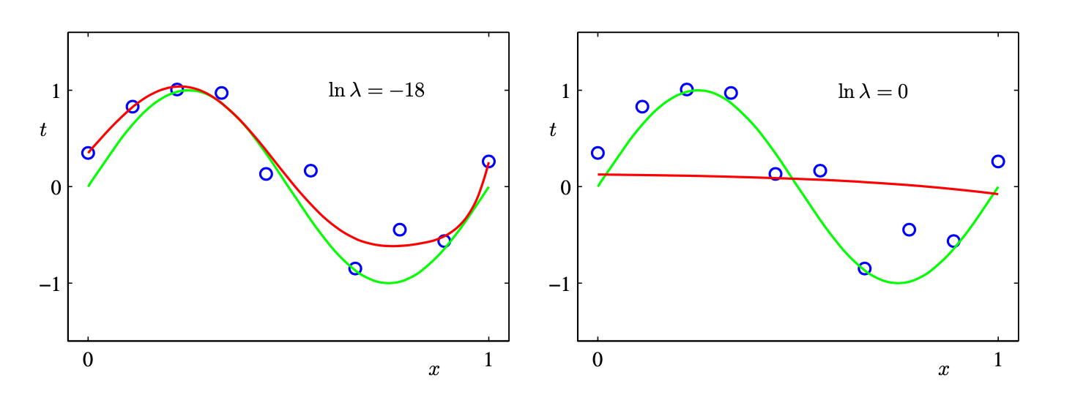
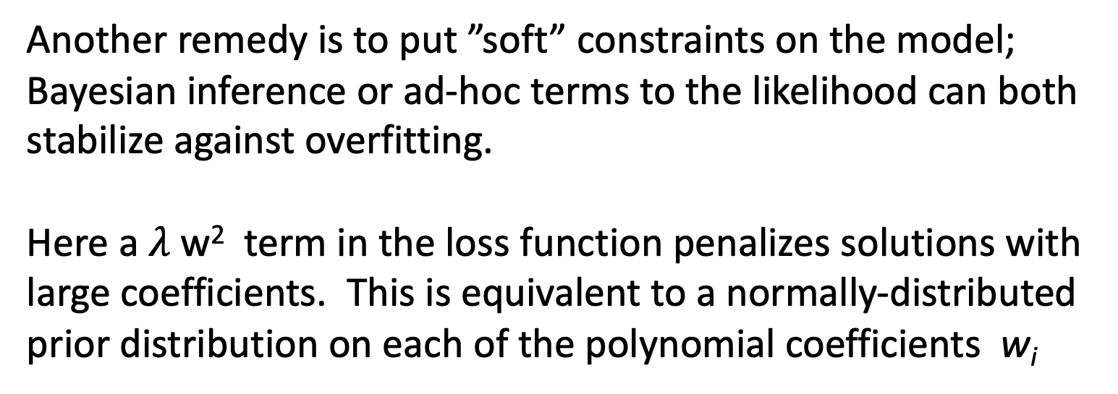
Don’t overfit: regularize
Another remedy is to put ”soft” constraints on the model; Bayesian inference or ad-hoc terms to the likelihood can both stabilize against overfitting.
Here a $λ$ w² term in the loss function penalizes solutions with large coefficients. This is equivalent to a normally-distributed prior distribution on each of the polynomial coefficients w_{i}

Slide 10
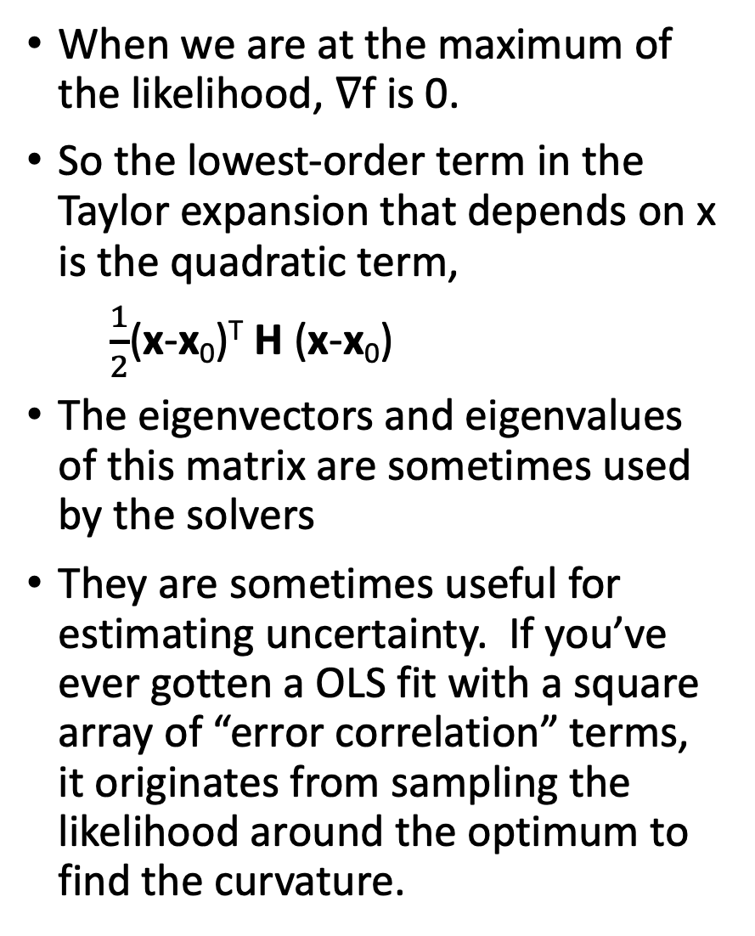
When we are at the maximum of the likelihood, ∇f is 0.
So the lowest-order term in the Taylor expansion that depends on x is the quadratic term,
$\frac{1}{2}$(x-x₀)^{T} H (x-x₀)
The eigenvectors and eigenvalues of this matrix are sometimes used by the solvers
They are sometimes useful for estimating uncertainty. If you’ve ever gotten a OLS fit with a square array of “error correlation” terms, it originates from sampling the likelihood around the optimum to find the curvature.

Slide 11
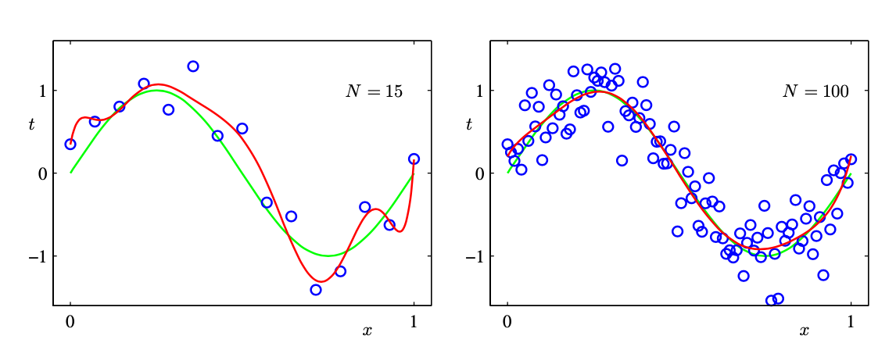
Don’t overfit: more data
One remedy is to include more data.
More terms in the likelihood (probably) will
guide us closer to a solution that is more generalizable
More terms in the likelihood makes the peak sharper

Slide 12
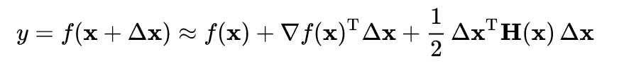
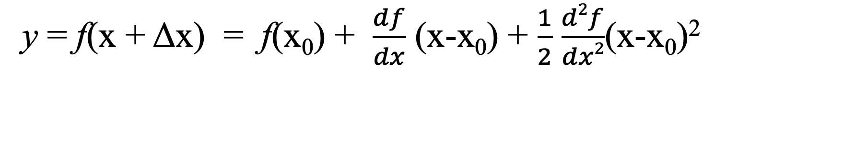
First and second derivatives in multiple dimensions
y = f(x + Δx) = f(x₀) + $\frac{df}{dx}$ (x-x₀) + $\frac{1}{2}$ $\frac{d2f}{dx2}$(x-x₀)²
What is f?
n x 1
n x n
symmetric
Which way is downhill?
Which way is the
maximum, minimum
curvature?

Slide 13
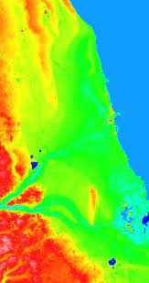
Gradient descent.. the simplest way to optimize
To find argmin_x f(x)
Start somewhere. x₀
Measure or estimate ∇f(x₀)
Set x₁ = x₀ - constant * ∇f(x₀)

Slide 14
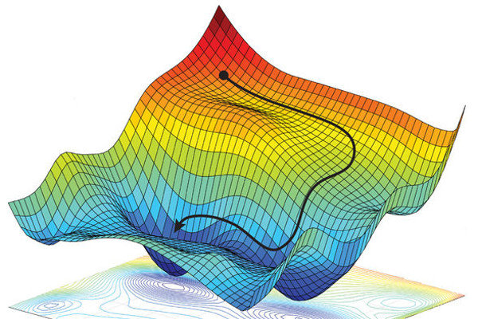

Slide 15
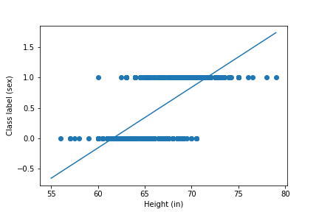
Linear regression on Galton height data

Slide 16
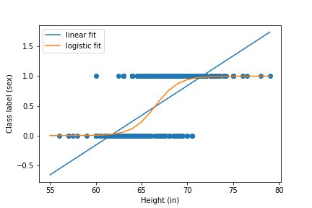
Logistic regression on Galton height data

